Slide 1

Life Saver
Blood Donation & Donor Finder App

Slide 2
Objectives
01
04
02
05
03
Enhance Blood Donation & Donor Experience
Expand Geographical Reach
Make It Easy To Find Blood Donor
Foster a collaborative donor and volunteer community for blood drives.
Improve Blood Supply Management

Slide 3
Introduction
Current Challenges in Blood Donation
Data Management
Information
Communication
Managing vast amounts of donor data is tough
Lack of real-time information.
Communicate with vast amount of donors is time consuming
Our Transformative Solution
Data Management
Information
Communication
Providing a centralized platform for managing donor data efficiently
Ensuring that up-to-date information is available
Features to see all available donors information at a glance

Slide 4
Recognition of Need
Blood Shortage
Ensuring Safety to Donor & Recipient.
Lack of Donor Engagement
Collaboration with Health Care Institutions
Insufficiencies in Blood Supply Chain

Slide 5
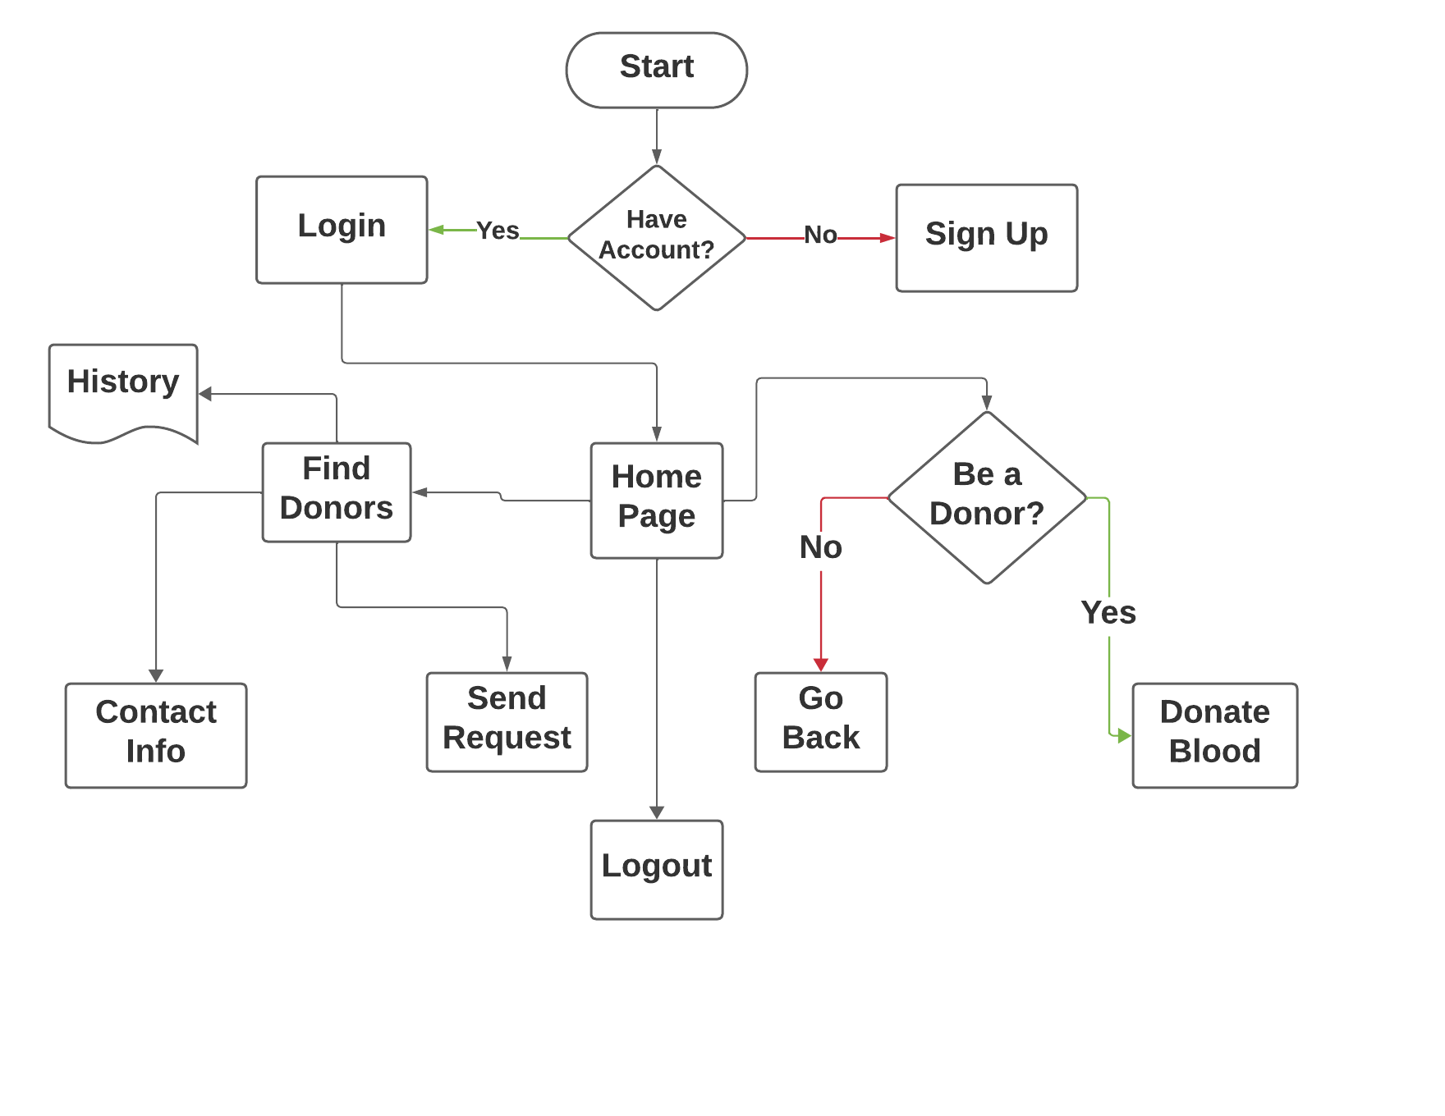
How It Works?

Slide 6
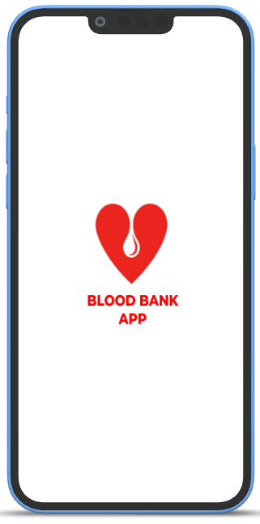
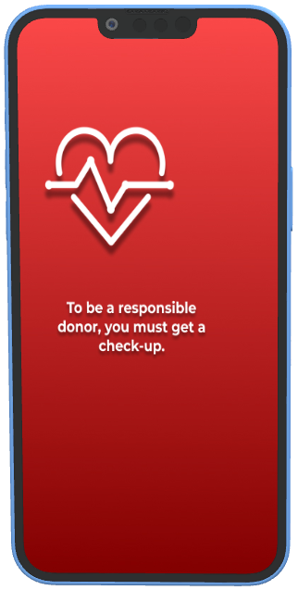
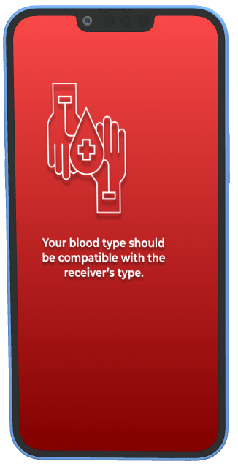
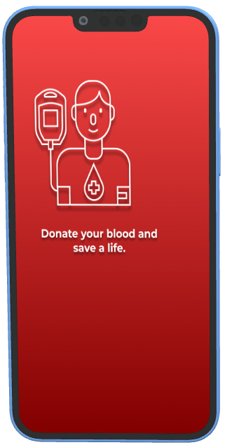
Splash Screen

Slide 7
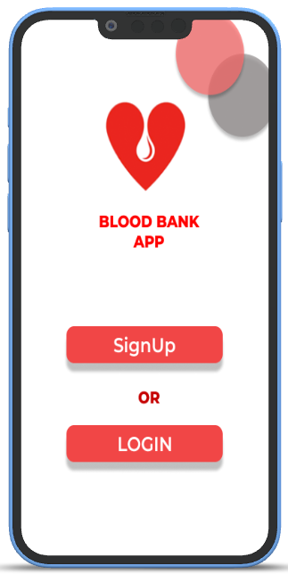
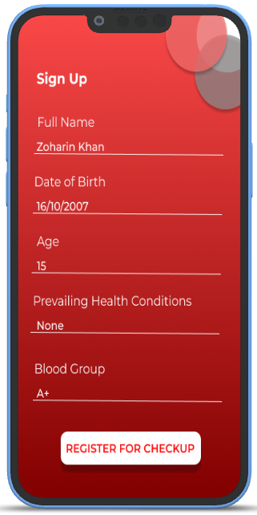
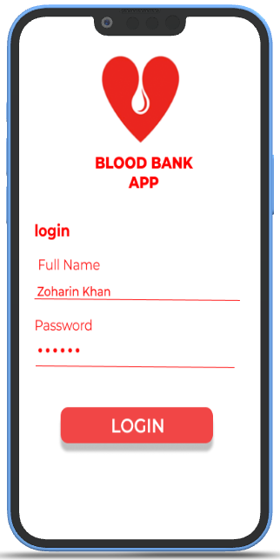
Login & Signup Page

Slide 8
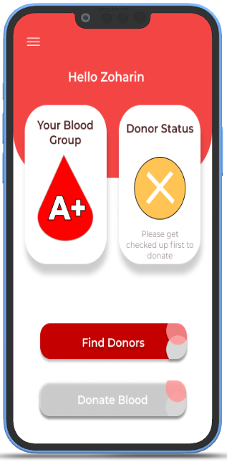
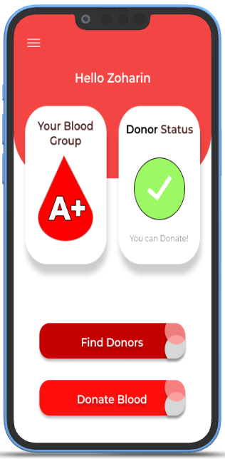
Home Screen
User Can Either be a donor or LOOK for donors

Slide 9
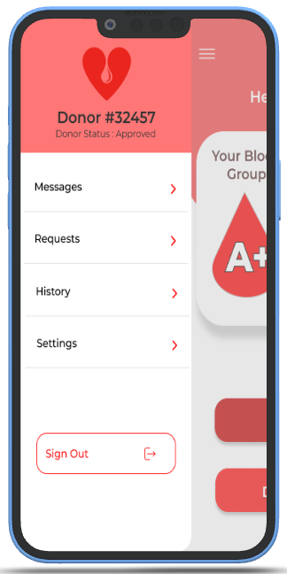
Navigation Drawer
A Navigation Drawer to Access any options

Slide 10
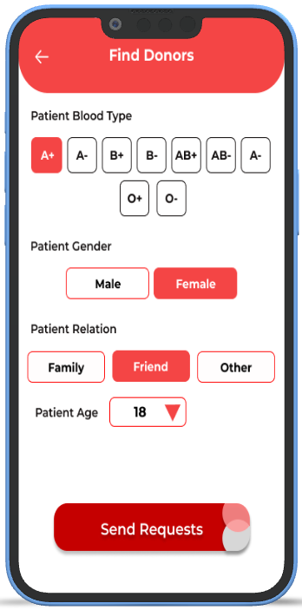
Request For Donor
User can Request for donor

Slide 11
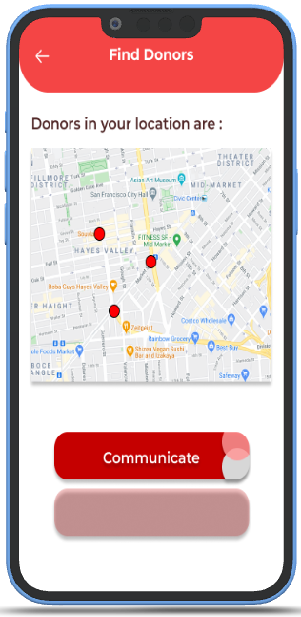
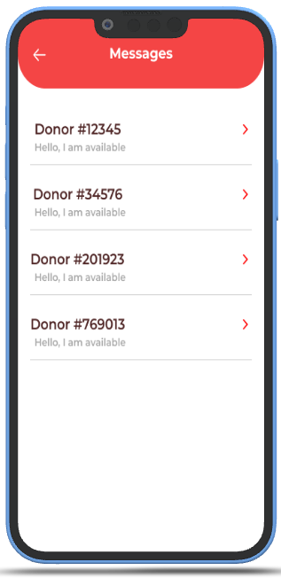
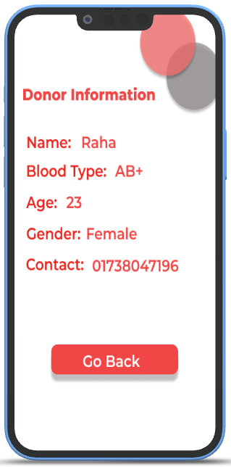
Connect To Donor
Can connect to nearby donors

Slide 12
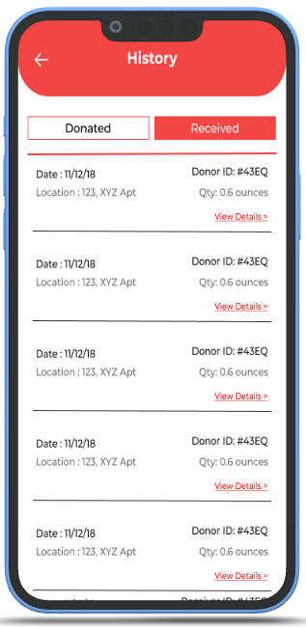
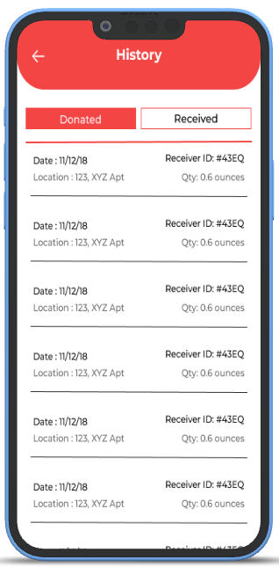
History

Slide 13
Why Choose Our Blood Donation App?
Efficient Donation Journey
Simplify your blood donation experience with our user-friendly app.
Lifesaving Impact, Personalized
Track your donations, monitor real-time supply levels, and receive gratitude from those you've helped, all in one place.
Community and Compassion
Connect with like-minded donors and volunteers. Stay updated on local drives and be part of a caring community.

Slide 14
Technology Used
Programming Language
Using Swift as the primary programming language for iOS app development. Swift is the official language for iOS development and offers a robust set of features for creating high-quality apps.
IDE
Xcode is the official IDE for iOS app development. It includes a code editor, interface builder, and debugging tools. We download Xcode from the Mac App Store.
Database
To store user data, donation records, and other information, we use a database system. Firebase by Firefox is popular choice. Firebase provides real-time database capabilities.
API
We use Google Map API to get and find the real-time location of a blood donor.
Json Parsing
When a user submits a donation record, app system can send the data to server using JSON and receive a confirmation or receipt in JSON format.

Slide 15
Our Team
Shrabanti Debnath Urmi
1907094
Tasfia Tasnim
1907102
1
2
Rubaiya Ratkin Raha
1907111
Sk. Azraf Sami
1907115
3
4
Md Raduan Islam Rian
1907117
5

Slide 16
Special Thanks To
Most. Kaniz Fatema Isha
Lecturer, CSE KUET
Argha Chandra Dhar
Lecturer, CSE KUET

